Slide 1
Polygon Rendering Methods

Slide 2
Rendering is the process of generating an image from a model.
Where model refers to description of three dimensional objects in a strictly defined language or data structure. It would contain geometry, viewpoint, texture and lighting information.
image is a digital image or raster graphics image

Slide 3
Polygon Rendering Method
Constant intensity shading (Flat shading)
Gouraud shading
Phong shading

Slide 4
Flat shading
Rendering objects with polygon surfaces.
Single intensity is calculated for each polygon
All points over the surface of the polygon are then displayed with same intensity values.

Slide 5
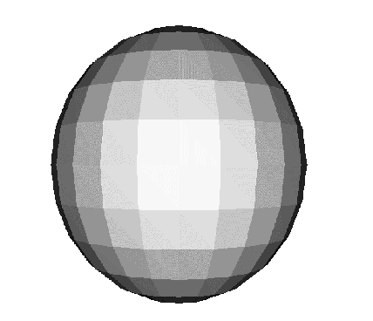
FLAT SHADING

Slide 6
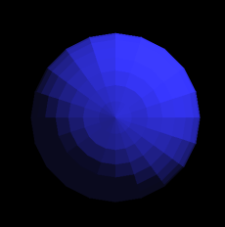
FLAT SHADING

Slide 7
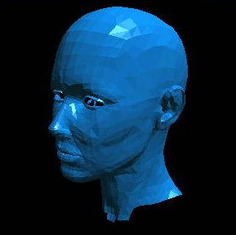
FLAT SHADING

Slide 8
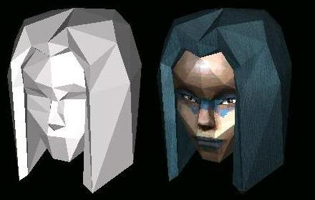
FLAT SHADING

Slide 9
Gouraud shading
Intensity interpolation scheme
Renders a polygon surface by linearly interpolating intensity across the surfaces.
Advantage->removes intensity discontinuities
Disadvantage->bright or dark intensity streaks appear on the surface.

Slide 10
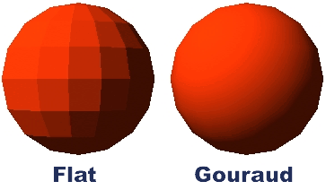
Gouraud Shading

Slide 11
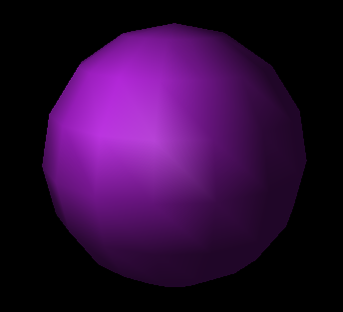
GOURAUD

Slide 12
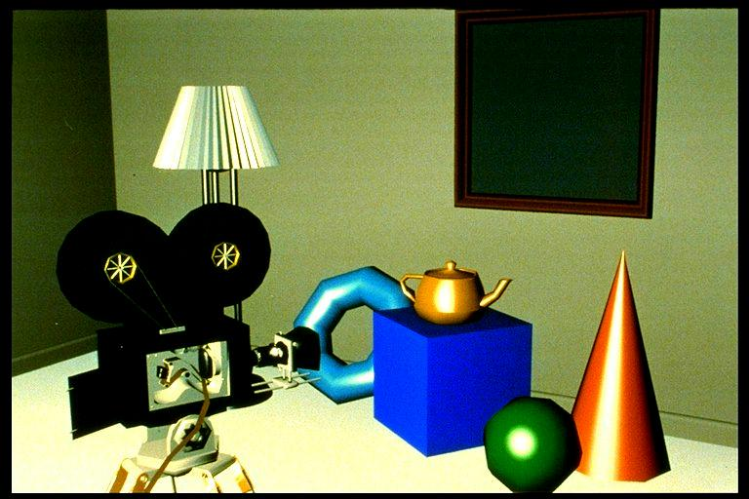
PHONG

Slide 13
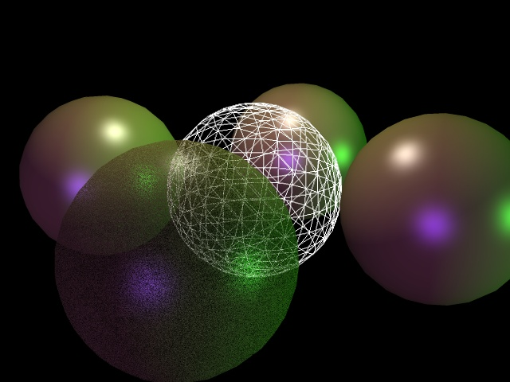
PHONG

Slide 14
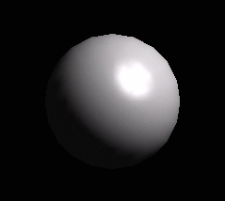
PHONG

Slide 15
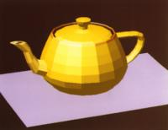
CONSTANT SHADING

Slide 16
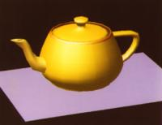
GOURAUD

Slide 17
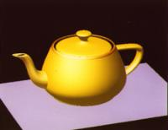
PHONG

Slide 18
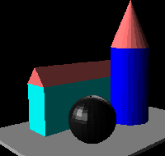
FLAT

Slide 19
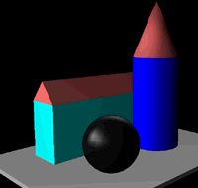
GOURAUD

Slide 20
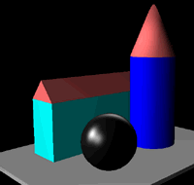
PHONG

Slide 21
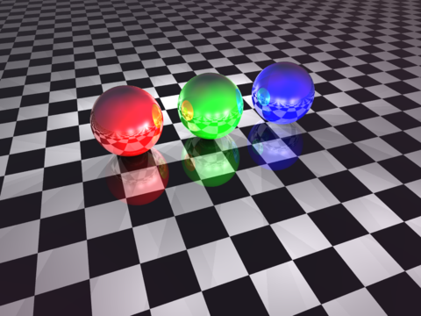
Ray tracing
Global illumination based rendering method

Slide 22
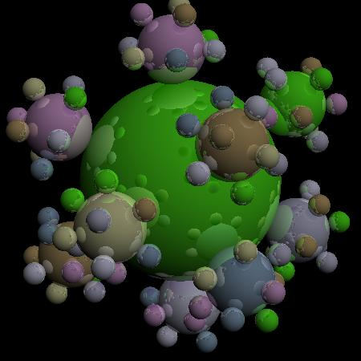
Ray traced image

Slide 23
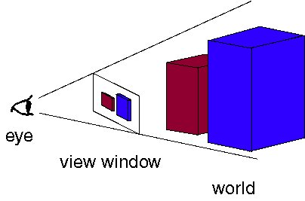
The eye, view window, and the world.
viewpoint -> The eye
World -> objects that you want to render
view window -n which we draw the scene

Slide 24
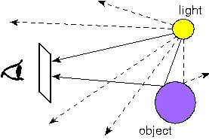
Tracing rays from the light source to the eye. Lots of rays are wasted because they never reach the eye.

Slide 25
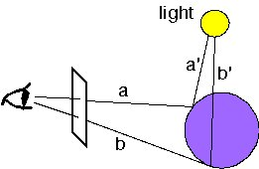
We trace a new ray from each ray-object intersection directly towards the light source

Slide 26
The End

